Slide 1
Omlsa + HPS study

Slide 2
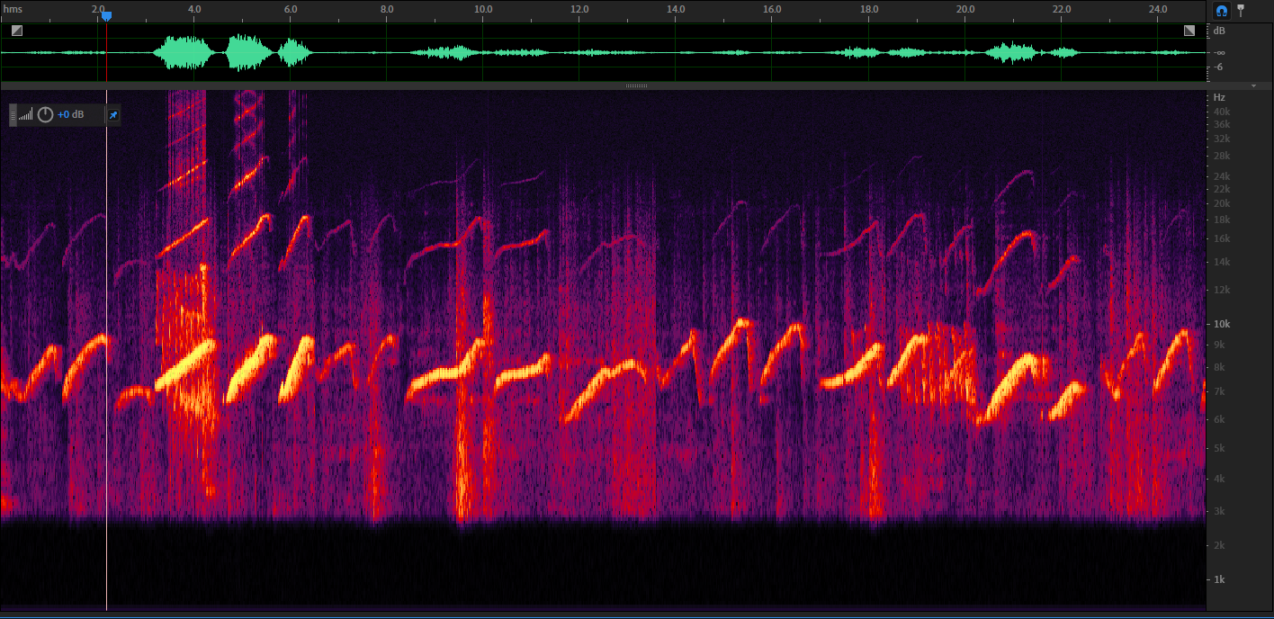
control

Slide 3
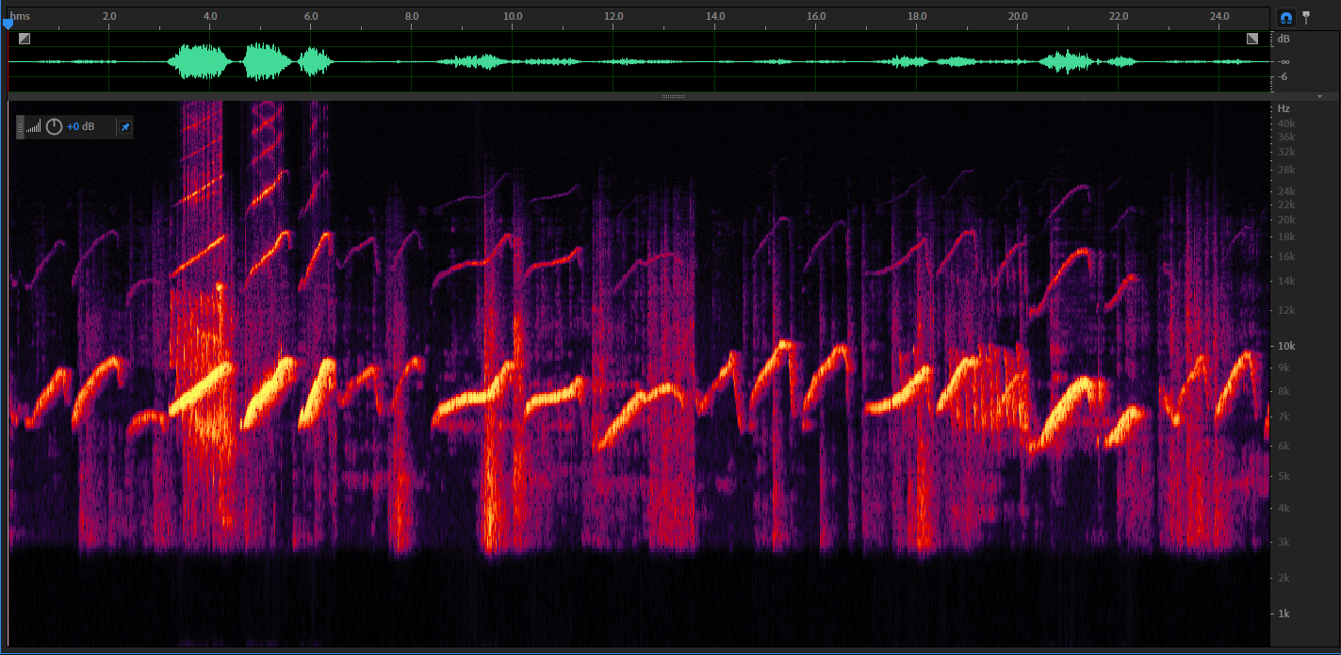
Control + omlsa (1st iteration)

Slide 4
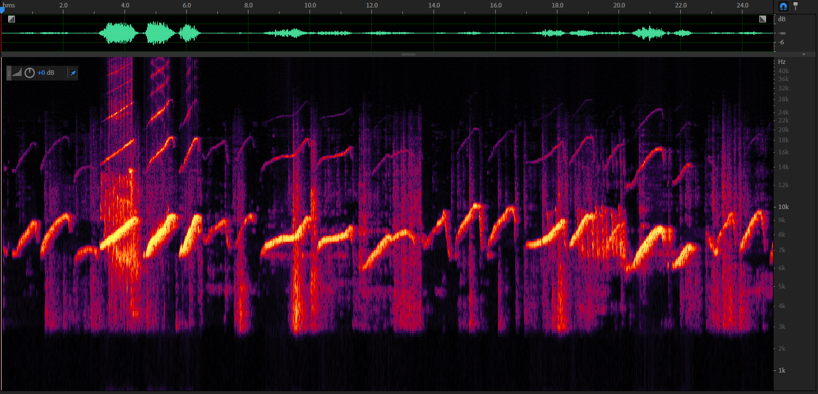
Control + omlsa (2nd iteration)

Slide 5
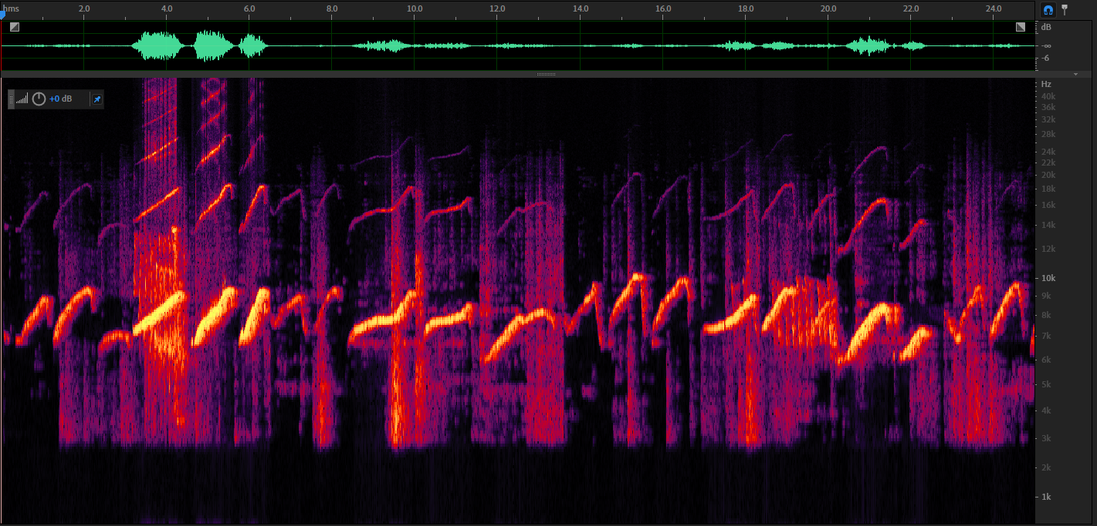
Control + omlsa (3rd iteration)

Slide 6
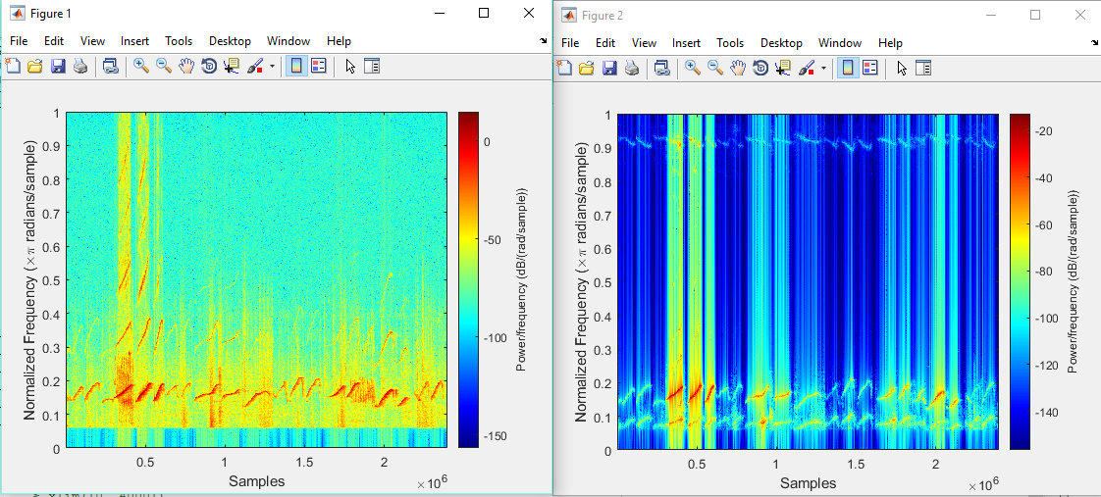
Control => HPS, R=2

Slide 7
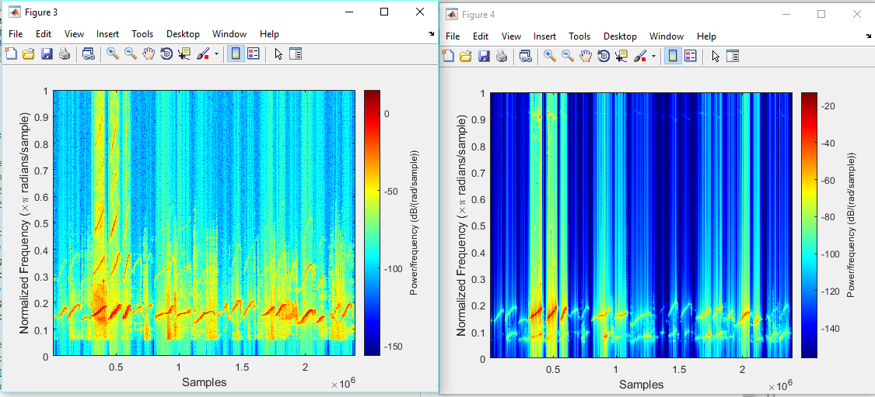
Control + omlsa (2 iterations) => HPS, R=2

Slide 8
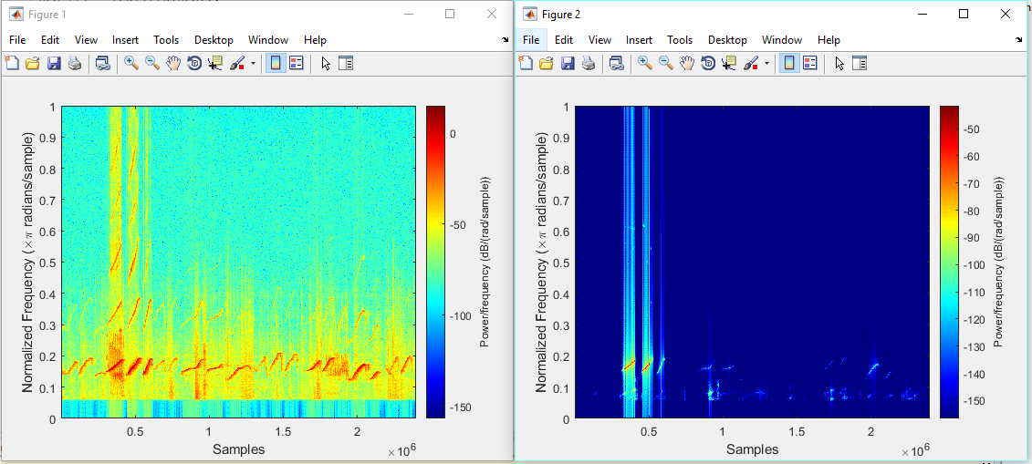
Control => HPS, R=3

Slide 9
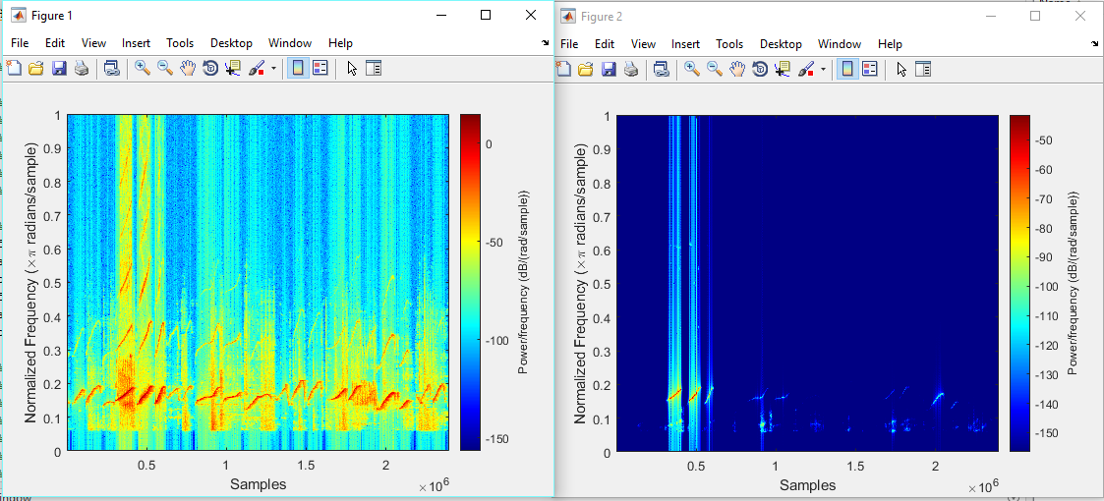
Control + omlsa (2 iterations) => HPS, R=3

